Slide 1

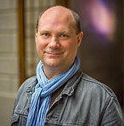
Arnold BARNA
Electrical engineer since 2000 (energy sector)
English (C1)
German (B2)
Seasoned project manager
08.12.2017

Slide 2
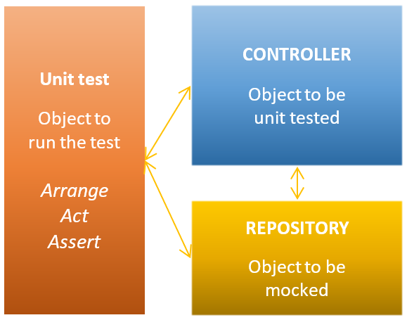
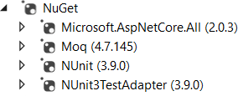
Mocking for unit testing
Technologies (NuGet)
Class Diagram
08.12.2017

Slide 3
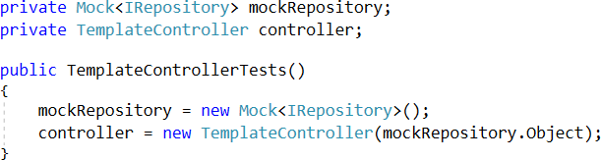
Fields and constructor in unit tests

Slide 4
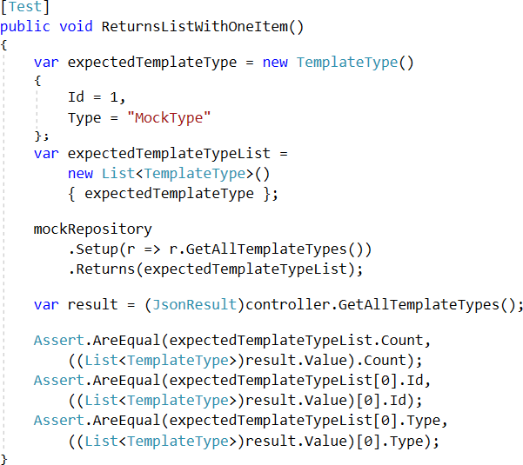
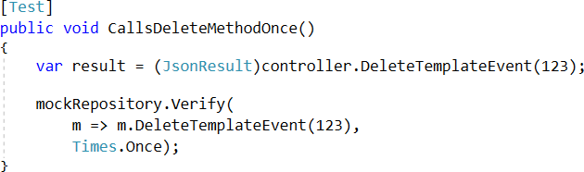
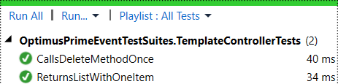
Unit test
Arrange
Act
Assert

